Slide 1


Will I Be Late? A study of SEPTA delays
Andrew Armstrong,
Abhay Bhat,
Alex Graber,
Eugene Olkhov,
Elizabeth Perkins

Slide 2
Background
Approximately 119,000 daily riders take advantage SEPTA’s Regional Rail system.
The SEPTA (Southeastern Pennsylvania Transportation Authority) Regional Rail system consists of commuter rail service on 13 branches to more than 150 active stations in Philadelphia, Pennsylvania, and its suburbs and satellite cities.
SEPTA reports On-Time Performance (OTP) to measure service reliability. OTP identifies the number of trains for all rail lines that arrive at their scheduled destination at the scheduled time.
A train may arrive up to 5 minutes and 59 seconds after its scheduled time and still be considered “on-time.”
SEPTA has set an On-Time Performance target such that 91% of its trains arrive on time.
Thus, even with 100% “on time” performance, trains may still arrive late, forcing commuters to deal with uncertainty and lost time – especially if they rely on back-to-back connections.
Notes:
SEPTA. “SEPTA Revenue & Ridership Report – March 2018.” http://septa.org/strategic-plan/reports/revenue-ride.pdf.
SEPTA. “SEPTA - Regional Rail.“ www.kaggle.com/septa/on-time-performance.

Slide 3
Objectives
Identify factors that are predictive of delay, including individual stations, line interactions, day-of-week, holidays, and weather.
Create a model(s) for each line (Paoli-Thorndale and Fox Chase) that will predict – given certain conditions – the likelihood that a given train will run late.
Identify the best models, and combine into an ensemble predictor.
Identify contributing factors of lateness in order to recommend potential course(s) of action to ameliorate delays.

Slide 4
Methodology
Aggregate data from various sources:
SEPTA OTP data is easily accessible due through Kaggle.com
Hour-by-hour historical weather information scraped from the DarkSky API per day and per locale
Train and validate models:
Logistic regressions,
Naïve Bayes,
Random Forest,
SVM,
Artificial neural network (ANN)

Slide 5
Key Takeaways

Slide 6
Data Aggregation & Cleaning

Slide 7
OTP Data Description
We used the On-Time Performance dataset provided by SEPTA to Kaggle.com. This “otp.csv” from the Kaggle dataset contains On-Time Performance information as from 23 Mar to 6 Nov, 2016 :
train_id
direction ('N' or 'S' direction is demarcated as either Northbound or Southbound)
origin (See map below - you'll see 'Warminster', 'Glenside',...'Airport Terminal..')
next_station (Think of this as the station stop, at timeStamp)
date
status ('On Time', '5 min', ... This is a status on train lateness. 999 is a suspended train)
Note: only 32% of trains run perfectly “on-time”, with another 30% running 1-3 minutes late and the remaining ~1/3 of the trains running >3 minutes late
timestamp

Slide 8
Weather Data Description
We collected weather data using the DarkSky API for the Philadelphia area for all start- and end-points of the Regional Rail lines we modeled. The data will be aggregated into a single file, allowing us to link it to the OTP data, and includes the following information:
time
summary
icon description
precipIntensity
precipProbability
temperature
apparentTemperature
dewPoint
humidity
pressure
windSpeed
windBearing
visibility cloudCover
precipType

Slide 9
Data Prep
Turn almost all of OTP into one-hot dummy variables (hour, day, month, stop, etc)
Combine OTP and weather data so that we have 1 row per stop per train trip per day
Standardize continuous variables
Identify missing data (12 values missing for wind speed); removed records
80 independent variables
174801 records

Slide 10
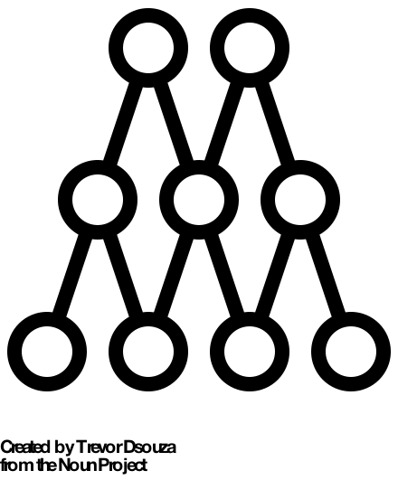
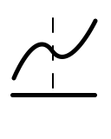



Algorithms
Random Forest
Logistic Regression
SVM
Neural Network
Naïve Bayes
Icons from the Noun Project: www.thenounproject.com

Slide 11
SVM Overview
SVM
SVM is a supervised learning classification algorithm
It finds the hyperplane that maximizes the margin separating each class (in this case, Late trains from On Time trains)
SVMs can use kernel space to help speed up nonlinear classification
SVM is an optimization problem and can be very computationally intensive
R has many SVM packages: e1071 and kernlab are the most popular
I implemented caret (which uses kernlab for svm) and has internal methods that support sampling, cross-validation, and testing

Slide 12
SVM Training
SVM
SVM models require hyperparameter tuning to optimize prediction accuracy
Linear SVM just requires identifying the Cost value that optimizes prediction
Radial SVM requires identifying Cost and sigma values
Polynomial SVM requires identifying Cost, degree, and scale
Optimal hyperparameters can be identified by running a grid search across a range of values. Multiple search runs are necessary to narrow down the optimal value. Random search algorithms like Simulated Annealing or Genetic algorithm may be helpful
Once optimal hyperparameters are found, Model training process (hyperparameter search, etc)

Slide 13
SVM Testing
SVM
Confusion Matrix and Statistics
ROC Curve
Prediction on.time late
on.time 8907 4295
late 8963 30276
Accuracy : 0.7472
95% CI : (0.7434, 0.7509)
No Information Rate : 0.6592
P-Value [Acc > NIR] : < 2.2e-16
Kappa : 0.3994
Mcnemar's Test P-Value : < 2.2e-16
Sensitivity : 0.4984
Specificity : 0.8758
Pos Pred Value : 0.6747
Neg Pred Value : 0.7716
Prevalence : 0.3408
Detection Rate : 0.1698
Detection Prevalence : 0.2517
Balanced Accuracy : 0.6871
AUC: 0.6871

Slide 14
SVM Insights
SVM
SVMs can be trained well with relatively little data. This is a good thing, because the optimizations require exponential time increases as the data size increases
Kernel selection and Hyperparameter tuning are very time intensive due to the number of training runs required (and the exponential time requirements)

Slide 15
Ensemble Predictions

Slide 16
Individual results vs Ensemble prediction

Slide 17
Additional Info

Slide 18
Key Predictors / Model Sparsity

Slide 19
Predictive Variables

Slide 20
Predictive variables

Slide 21
Predictive variables

Slide 22
PCA Analysis
 | 3 |  |  | 4
originFrazer.Yard | -0.514 |  | precipIntensity | 0.425
originThorndale | 0.508 |  | precipProbability | 0.420
day_of_weekSunday | -0.314 |  | originJefferson.Station | 0.326
delay | 0.285 |  | visibility | -0.278
precipProbability | -0.204 |  | temperature | 0.254
 |  |  | delay | 0.227
 |  |  | originFrazer.Yard | -0.212

Slide 23
Time Series analysis

Slide 24
Conclusion

Slide 25
Will I be Late?
Model predicts % accurately
Key Predictors

Slide 26
Suggestions for SEPTA & its riders

Slide 27
Next Steps

